Slide 1
Data Management CT051-3-M
Topic 8 – HIVE

Slide 2
Topic & Structure of Lesson
What is Hive?
Hadoop Framework
Hadoop’s Architecture
Hadoop in the Wild
Data warehouse to Hadoop

Slide 3
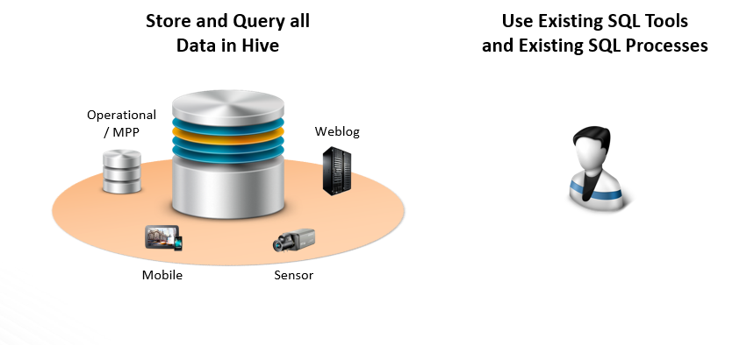
About Hive
Notes:
Apache Hive is a data warehouse system for Hadoop. Hive is not a relational database; it only maintains metadata information about your big data stored on HDFS.

Slide 4
About Hive – cont.
It is a data warehouse system for Hadoop
It maintains metadata information about your big data stored on HDFS
It treats your big data as tables
It performs SQL-like operations on the data using a scripting language called HiveQL
Notes:
For most use cases:
- Pig is a good choice for ETL jobs, where unstructured data is reformatted so that it is easier to define a structure to it
- Hive is a good choice when you want to query data that has a certain known structure to it

Slide 5
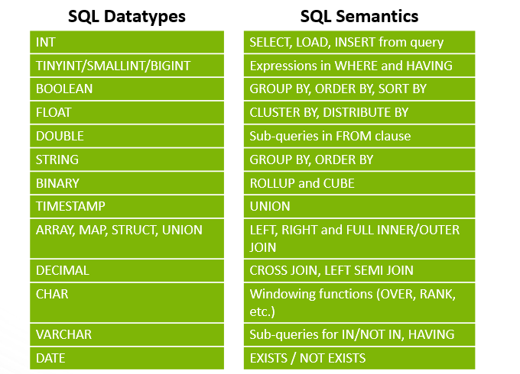
Hive’s Alignment with SQL

Slide 6
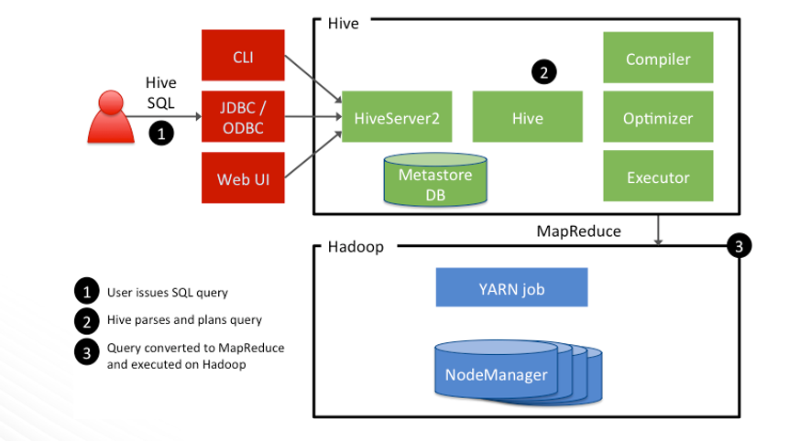
Hive Architecture

Slide 7
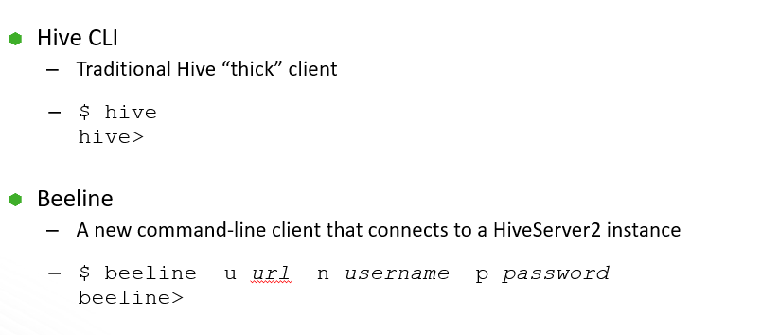
Submitting Hive Queries

Slide 8
Defining a Hive-Managed Table
CREATE TABLE customer (
customerID INT,
firstName STRING,
lastName STRING,
birthday TIMESTAMP
) ROW FORMAT DELIMITED
FIELDS TERMINATED BY ',';

Slide 9
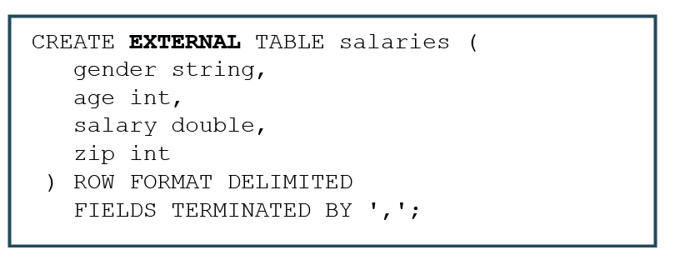
Defining an External Table

Slide 10
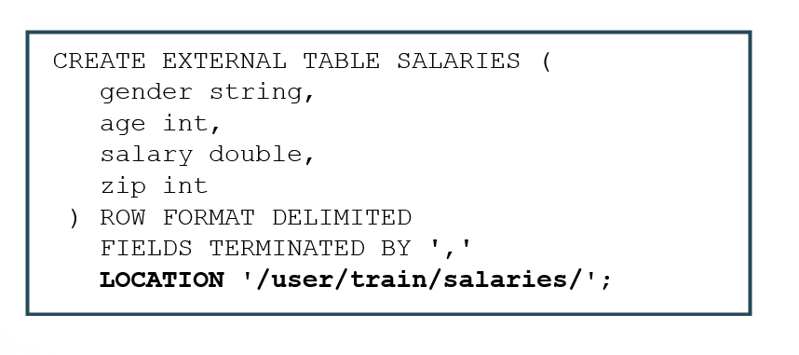
Defining a Table LOCATION

Slide 11
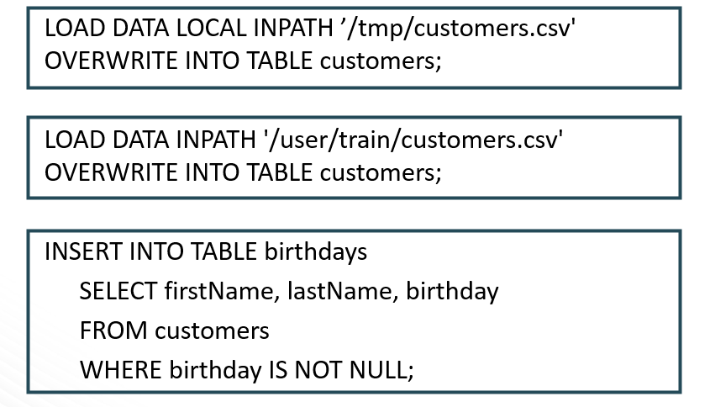
Loading Data into Hive
Notes:
The data does not actually get “loaded” into anything, but the data does get moved:
- For Hive-managed tables, the data is moved into a special Hive subfolders of /apps/hive/warehouse
- For external tables, the data is moved to the folder specified by the LOCATION clause in the table’s definition

Slide 12
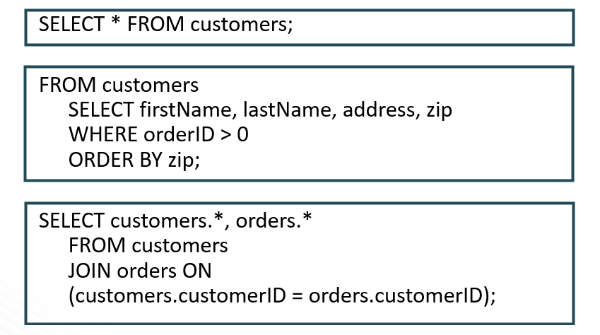
Performing Queries

Slide 13
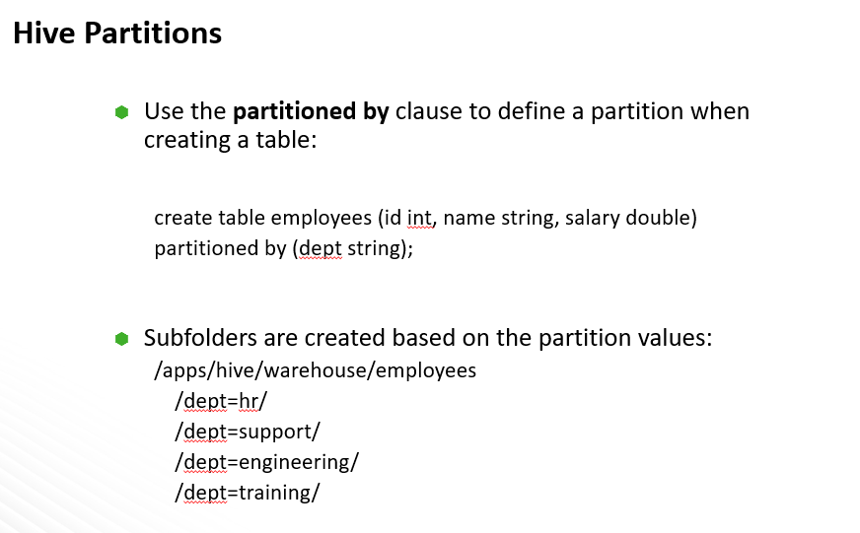
Lab: Understanding Hive Tables

Slide 14
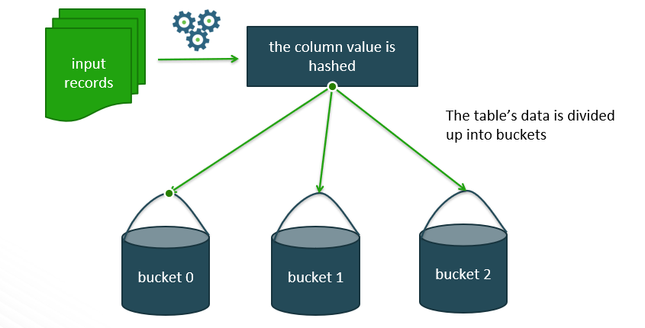
Hive Buckets

Slide 15
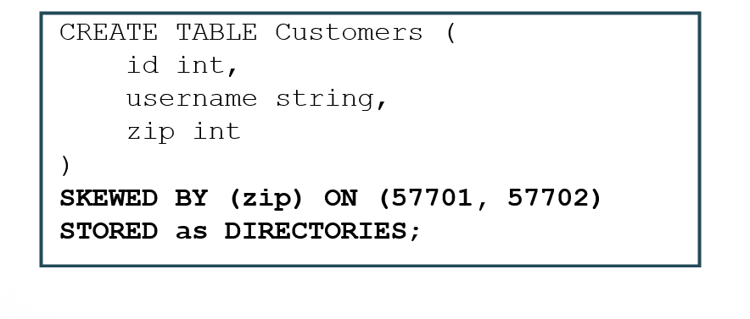
Skewed Tables
Notes:
By specifying the values with heavy skew, Hive will split those out into separate files automatically and take this fact into account during queries so that it can skip whole files if possible.

Slide 16
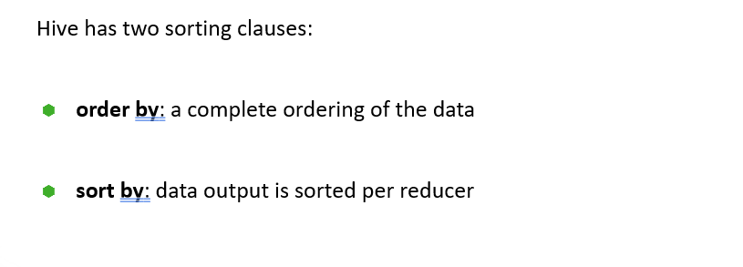
Understanding Partitions and Skew
Sorting Data

Slide 17
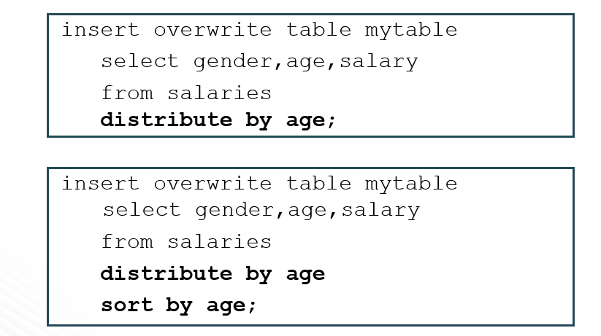
Using Distribute By

Slide 18
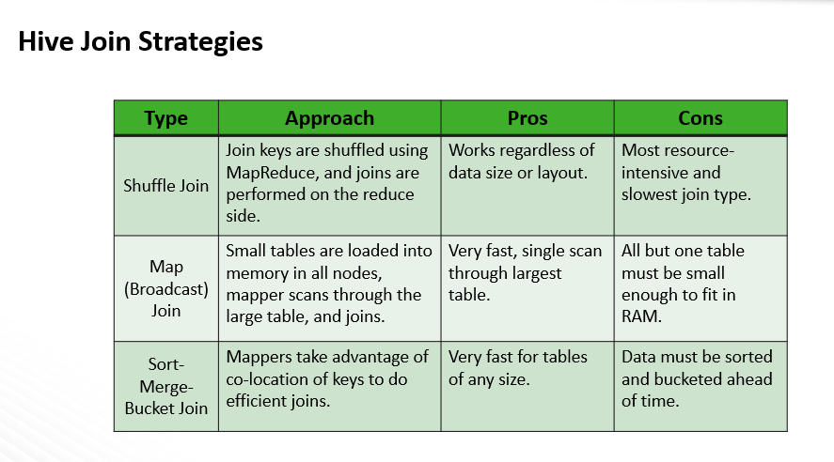
Analyzing Big Data with Hive
Notes:
- Shuffle joins always work in the sense that if you cannot perform a more efficient type of join, two tables can always be joined using a shuffle join
- A map join is very efficient and ideal if one side of the join is a small enough dataset to fit into memory
- If a map join is not an option, then the next best option is a sort-merge-bucket join, which we will discuss in more detail.

Slide 19
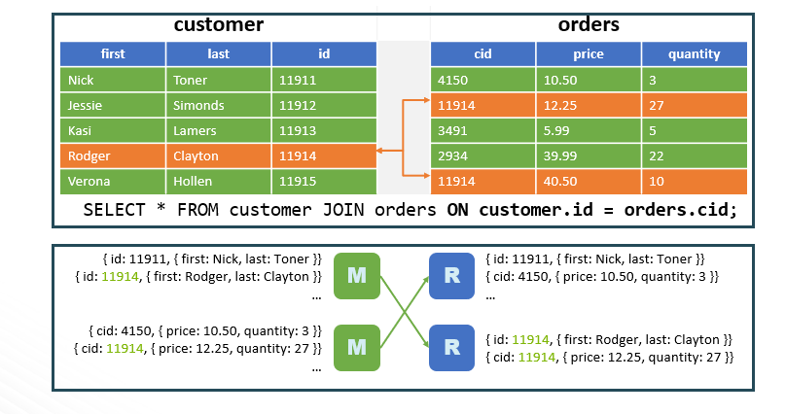
Shuffle Joins
Notes:
This is the first of 3 slides that have the exact same SELECT query, but each one executes differently. This one runs as a shuffle join. A shuffle join is the default join technique for Hive, and it works with any data sets (no matter how large).

Slide 20
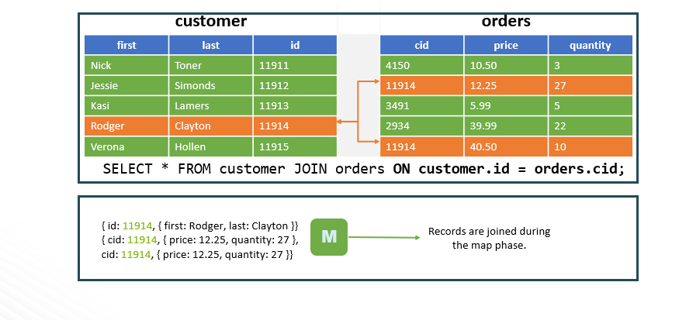
Map (Broadcast) Joins
Notes:
If one of the datasets is small enough to fit into memory, then it can be distributed (broadcast) to each mapper and perform the join in the map phase.
In HDP 2.x, Hive joins are automatically optimized without the need for providing hints.

Slide 21
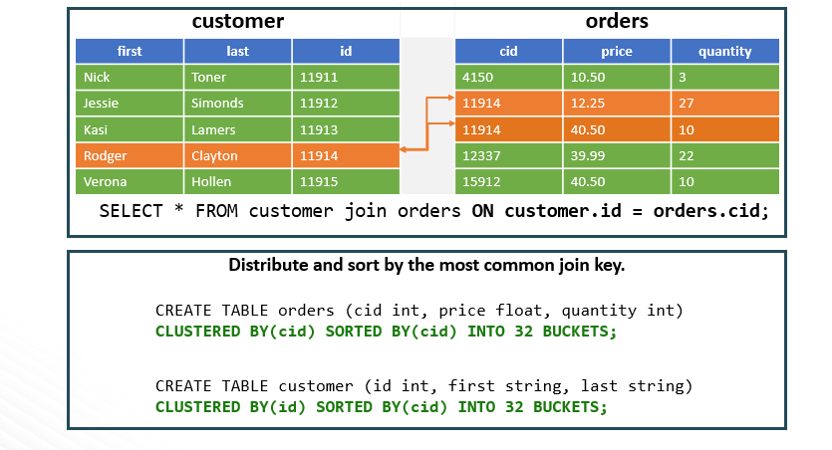
Sort-Merge-Bucket Joins
Notes:
If you have two datasets that are too large for a map-side join, an efficient technique for joining them is to sort the two datasets into buckets. The trick is to cluster and sort by the same join key.

Slide 22


Slide 23
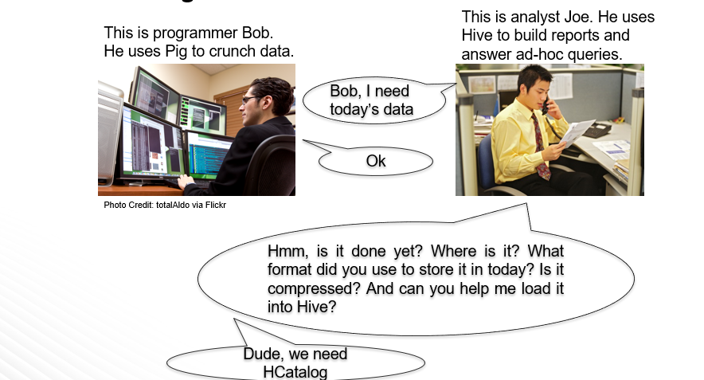
About HCatalog
Notes:
Makes the Hive metastore available to users of other tools on Hadoop
Provides connectors for MapReduce and Pig so that users of those tools can read data from and write data to Hive’s warehouse
Allows users to share data and metadata across Hive, Pig, and MapReduce
Provides a relational view through an SQL-like language (HiveQL) to data within Hadoop
Allows users to write their applications without being concerned about how or where the data is stored
Insulates users from schema- and storage-format changes

Slide 24
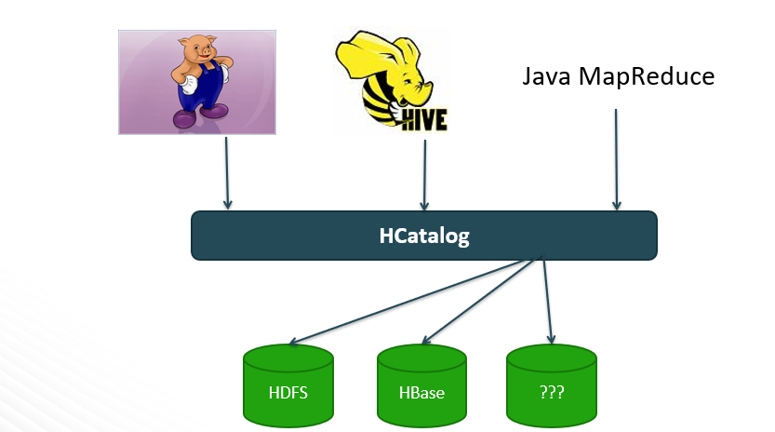
HCatalog in the Ecosystem
Notes:
HCatalog provides a consistent data model for the various tools that use Hadoop. It also provides table abstraction, which abstracts some of the details about your data like:
How the data is stored
Where the data resides on the filesystem
What format that data is in
What the schema is of the data

Slide 25


Slide 26
About HDFS Federation
According to Merriam-Webster’s dictionary: a federation is an organization or group within which smaller divisions have some degree of internal autonomy
HDFS Federation refers to the ability of NameNodes to work independently of each other
Notes:
The new Hadoop infrastructure provides for multiple NameNodes that run independently of each other providing:
-Scalability
NameNodes can now scale horizontally, allowing you to improve the performance of NameNode tasks by distributing reads and writes across a cluster of NameNodes
-Namespaces
The ability to define multiple Namespaces allows for the organizing and separating of your big data
Federation is not officially supported in HDP yet.

Slide 27
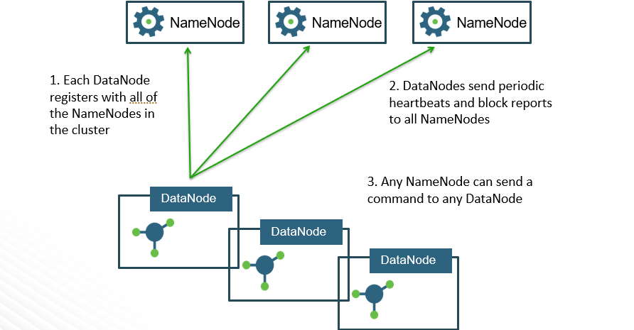
Multiple Federated NameNodes
Notes:
The NameNodes are federated: that is, the NameNodes are independent and don’t require coordination with each other.
The DataNodes are used as common storage for blocks by all of the NameNodes.
As of HDP 2.3, Hortonworks does NOT support the use of HDFS Federation

Slide 28
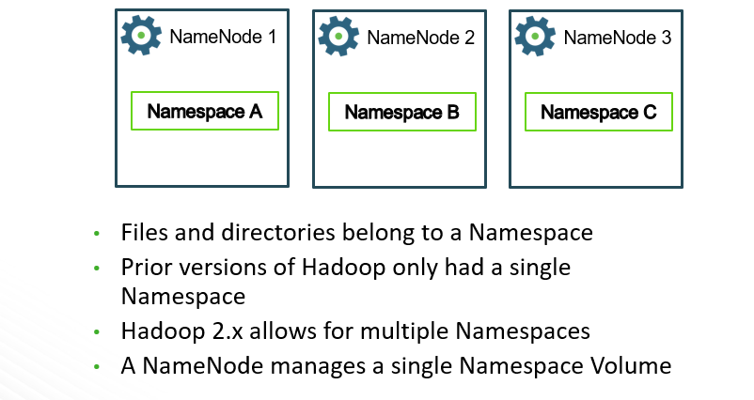
Multiple Namespaces
Notes:
Benefits of multiple Namespaces include:
Scalability
Having multiple independent Namespaces is what makes scaling possible in Hadoop 2.x
File Management
You can now associate your big data with a Namespace, making it easier to manage and maintain files

Slide 29
About YARN
YARN = Yet Another Resource Negotiator
YARN splits up the functionality of the JobTracker in Hadoop 1.x into two separate processes:
ResourceManager: for allocating resources and scheduling applications
ApplicationMaster: for executing applications and providing failover
Notes:
YARN takes Hadoop beyond just MapReduce for data processing. You will still be able to execute MapReduce jobs across your Hadoop cluster, but YARN provides a generic framework that allows for any type of application to execute on the big data across your clusters.

Slide 30
Open-source YARN Use Cases
Tez: improves the execution of MapReduce jobs
Slider: deploy existing frameworks on YARN
Storm: for real-time computing
Spark: a MapReduce-like cluster computing framework designed for low-latency iterative jobs and interactive use from an interpreter
Apache Giraph: a graph-processing platform

Slide 31
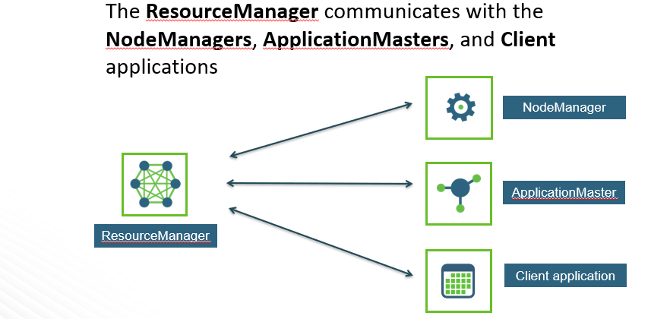
The Components of YARN
Notes:
The ResourceManager allocates resources for applications but does not manage the lifecycle of applications. Instead, applications are managed by an ApplicationMaster that runs on a node in the cluster. Each application running in the cluster requires its own ApplicationMaster.

Slide 32
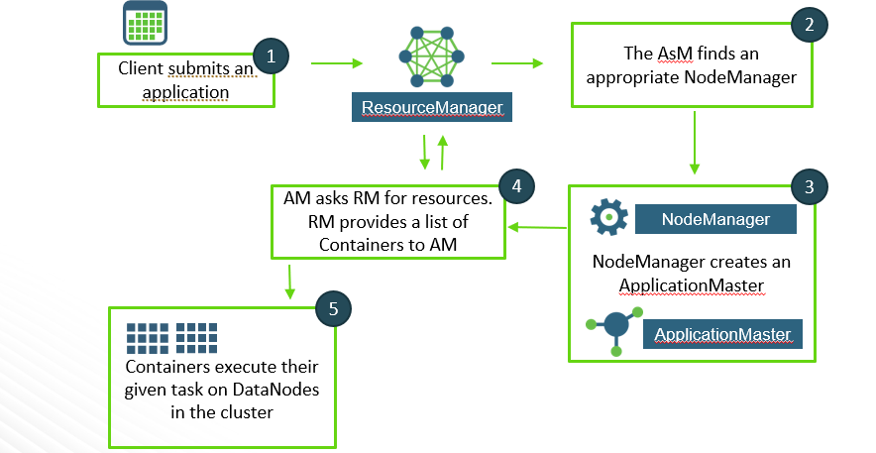
Lifecycle of a YARN Application

Slide 33
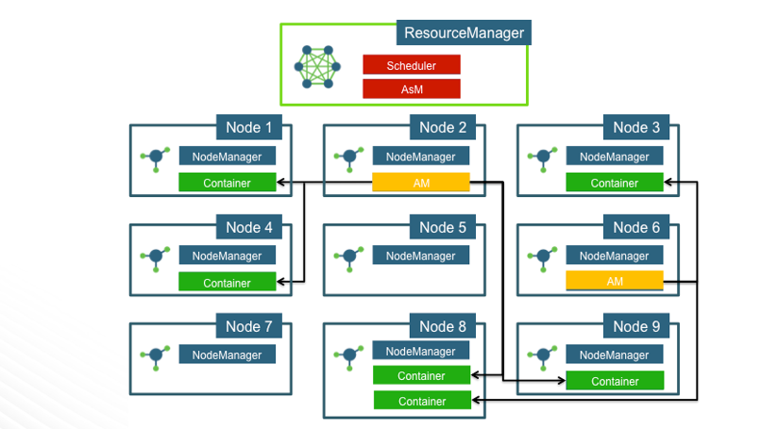
A Cluster View Example
Notes:
1. How many applications are running on the cluster above?
2. How many containers are being used by the application controlled by the AM on Node 2?
3. Node 8 appears to have two Containers running on it. Is this allowed in YARN?
4. Is it possible that a Container could be executed on the same node as its corresponding AM?
Answers:
Two
Four
Certainly
Yes. It all depends on the availability of resources on a node.

Slide 34
Question & Answer Session
Q & A

